Slide 1
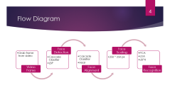

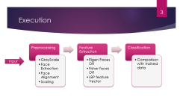
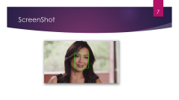




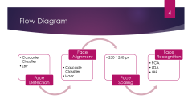



∆-Facer

Slide 2

Intro
Face Recognizer in video
Multiple classifiers
Face Detection & Alignment
Face Recognition
Developed using OpenCV in Python
Notes:
LBPH – Local Binary Pattern Historgram

Slide 3
Execution
Preprocessing
GrayScale
Feature Extraction
Eigen Faces OR
Classification
Comparison with trained data
Face Extraction
Face Alignment
Scaling
Fisher faces OR
LBP feature Vector
Input

Slide 4
Flow Diagram
Face Detection
Cascade Classfier
Face Alignment
Face Scaling
LBP
Cascade Classifier
Haar
250 * 250 px
Face Recognition
PCA
LDA
LBPH
Video Frame
Grab frame from video

Slide 5
Training Data
http://www.msceleb.org/
System Trained to Recognize
Jennifer Anniston
Justing Beiber
Sasha Pieterse
Sean Maher
Ming Na Wen

Slide 6
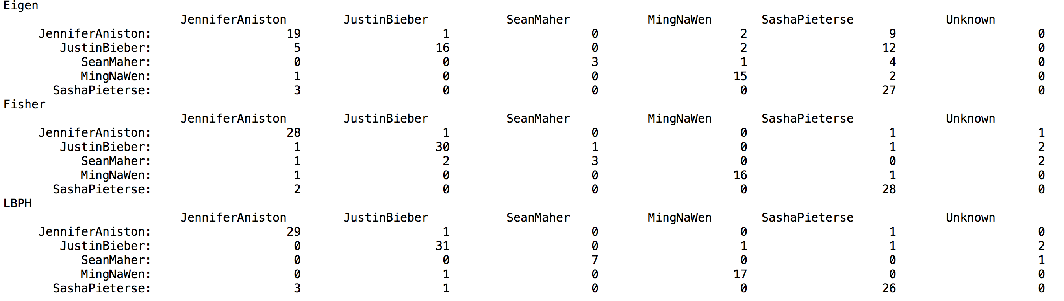
Confusion Matrix

Slide 7
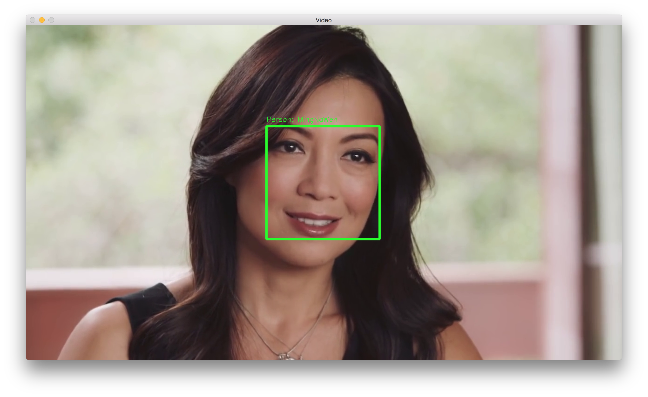
ScreenShot

